Slide 1
Predict Price of Airline Tickets
Machine learning model project

Slide 2
CONTENT
Overview
About dataset
Domain study
Data Analysis
Apply linear regression (ML)

Slide 3
OVERVIEW
In this project, we will be analyzing the airlines tickets price prediction using Machine Learning dataset using essential data analysis techniques then will test predictions about the price of the flight based on some features such as what is the arrival time, what is the departure time, what is the duration of the flight, source, destination and more.

Slide 4
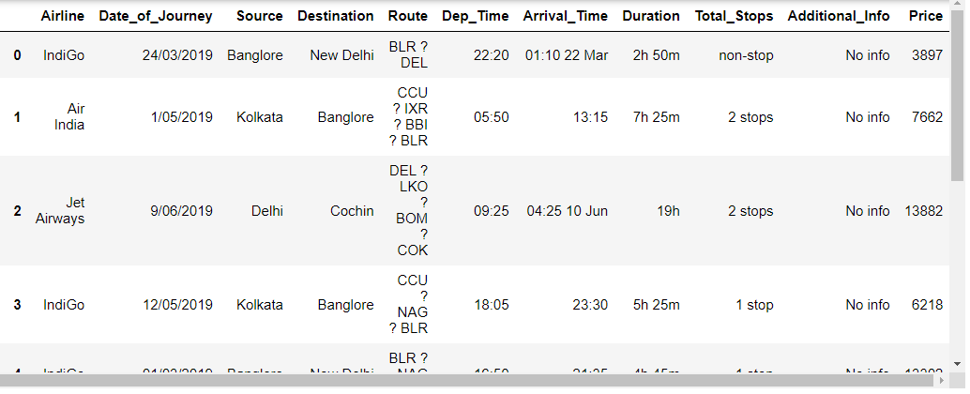
About the dataset
Dataset Vision:

Slide 5
About the dataset
Airline: So this column will have all the types of airlines like Indigo, Jet Airways, Air India, and many more.
Date_of_Journey: This column will let us know about the date on which the passenger’s journey will start.
Source: This column holds the name of the place from where the passenger’s journey will start.
Destination: This column holds the name of the place to where passengers wanted to travel.
Route: Here we can know about that what is the route through which passengers have opted to travel from his/her source to their destination.

Slide 6
About the dataset
Arrival_Time: Arrival time is when the passenger will reach his/her destination.
Duration: Duration is the whole period that a flight will take to complete its journey from source to destination.
Total_Stops: This will let us know in how many places flights will stop there for the flight in the whole journey.
Additional_Info: In this column, we will get information about food, kind of food, and other amenities.
Price: Price of the flight for a complete journey including all the expenses before onboarding.

Slide 7
Domain study
The price of a ticket of an airline changes very quickly these days, and the difference is a lot. It can vary even in a few hours for the same flight or even the some particular. Customers want to get the cheapest price possible while the airline companies want the maximum profit and revenue possible.
The Flight ticket prices increase or decrease every now and then depending on various factors like timing of the flights, destination, duration of flights. In the proposed system a predictive model will be created by applying machine learning linear regression algorithm to the collected historical data of flights.

Slide 8
Domain study
To determine the price of the flight ticket, the airlines first determine the type of aircraft they will use on the trip, and this will determine for them the booking classes, classes of travel and the number of seats available in each of them. Each booking class has different rules and restrictions, the cost of changing or refunding a ticket also varies widely, and each booking class has a different price based on those factors. Although there may be 100 seats in Economy Class, there may only be 10 seats in each different package. The reason there are all these booking categories is that airlines are trying to maximize profits.

Slide 9
Domain study
They know that there are two types of travelers: the first type is leisure travelers or tourists, who are more flexible in time and often book well in advance of departure, They are usually the ones who book the cheapest flights. The second type are business travelers who have limited time, and are often willing to pay more for a particular ticket, so the closer to the departure time, the more expensive the seats available.

Slide 10
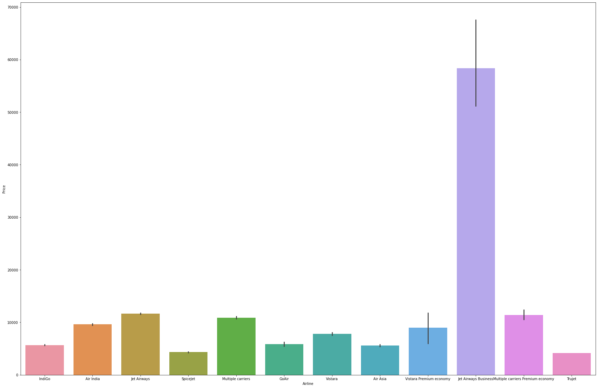
Data analysis
This plot describes the mean value of prices for each airline organization
As shown (barplot): The highest mean of prices belonged to Jet Airways Business

Slide 11
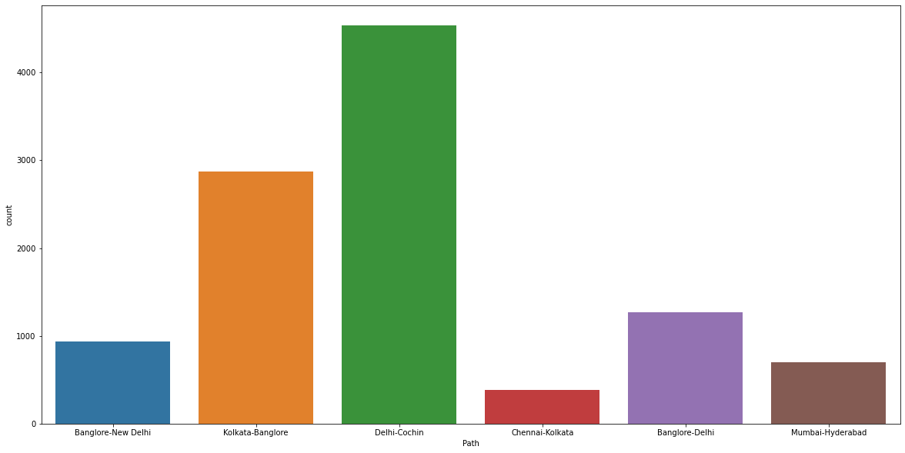
Data analysis
This plot shows the number of trips recorded for each path (Same source&dest.)
As shown (countplot): The highest repeated path is Delhi-to-Cochin path

Slide 12
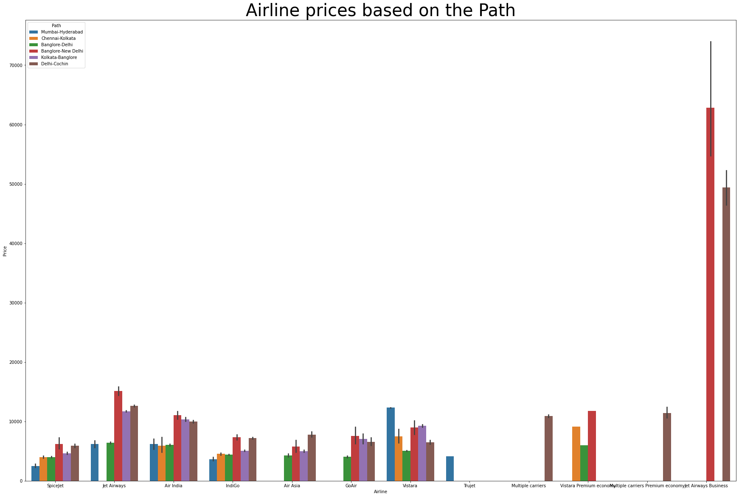
Data analysis
This plot shows the mean of prices for each path supported by each airline
As shown (barplot): The paths with highest prices at all are Delhi-to-Cochin,
Banglore-New Delhi

Slide 13
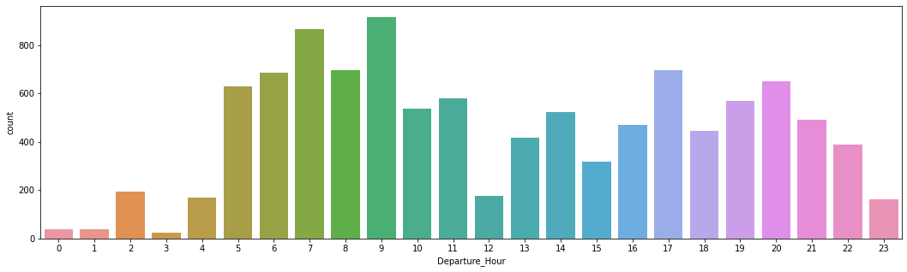
Data analysis
This plot shows the number of repetitions of trips those have the same Dep_hour
As shown (countplot): Most of the flights took off during the period from 7 to 9 Am

Slide 14
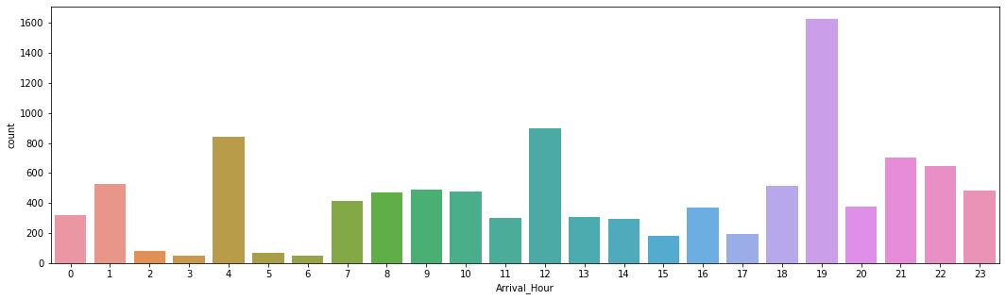
Data analysis
This plot shows the number of repetitions of trips those have the same Arrival_hour
As shown (countplot): Most flights land at 4 am, 12 pm and 7 pm

Slide 15
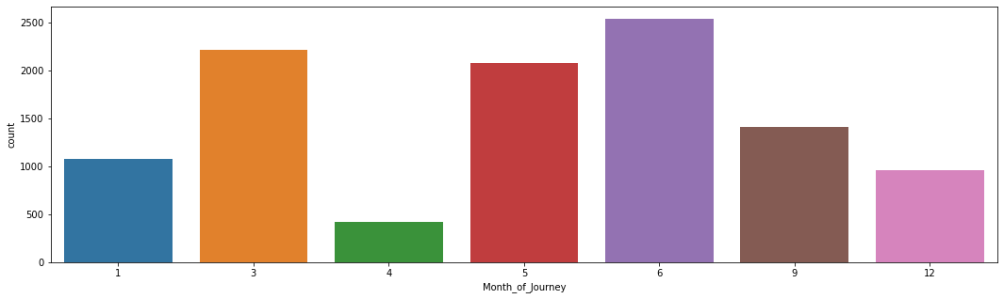
Data analysis
This plot shows the number of trips those occurred in the same month
As shown (countplot): Most flights happened in March, May and June (it may related to public holidays in India)

Slide 16
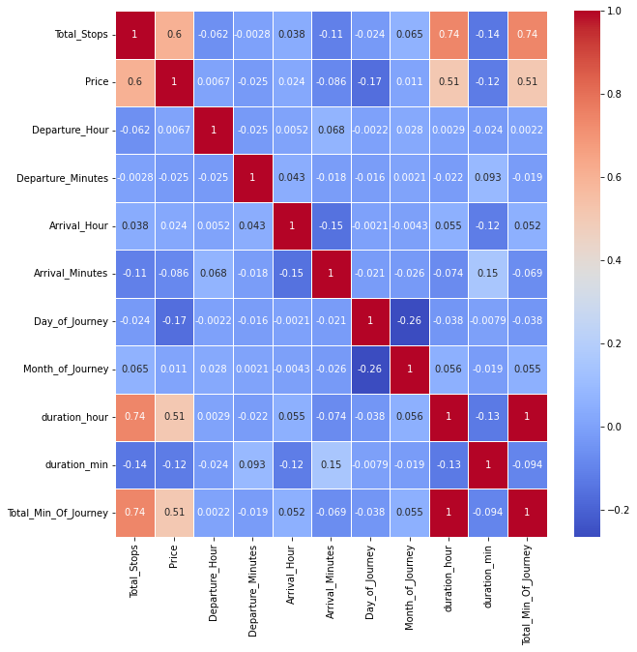
Data analysis
This map declared the correlation between featured columns and price column.
As shown (Heatmap): Most correlated columns to price are (Total_Stops & Duration_Hour)

Slide 17
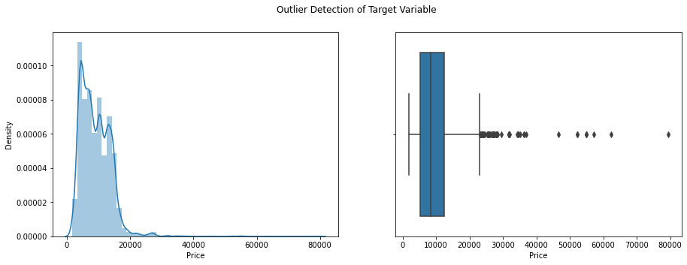
Data analysis
This distplot shows the Distribution of the price in dataset, and boxplot shows the price outliers.
As shown (distplot & boxplot): Most prices repeated between 5,000 to 10,000 pound, and data outliers above 40,000 pound.

Slide 18
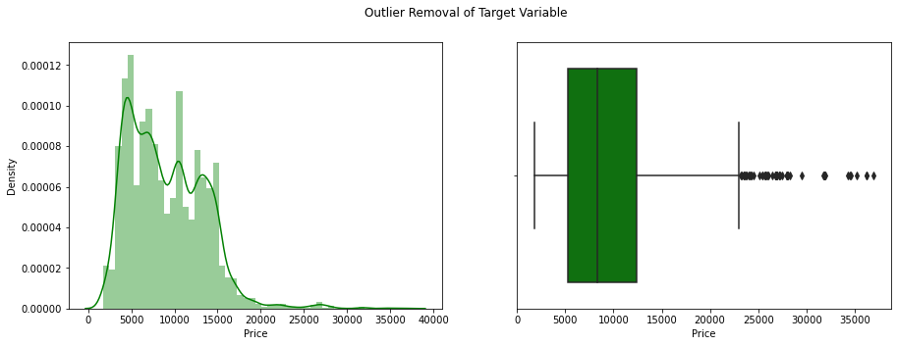
Data analysis
This distplot shows the Distribution of the price in dataset, and boxplot shows the price outliers getting removed.
As shown (boxplot): We removed price outliers that above 40,000 pound.

Slide 19
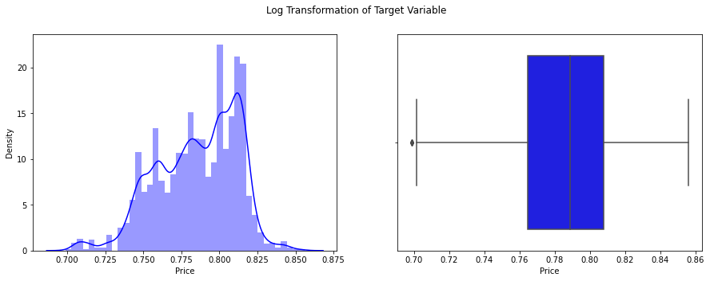
Data analysis
This distplot shows the Distribution of the price in dataset after applying log transformation to price column, and boxplot shows the price outliers.
As shown (boxplot): We removed price outliers that above 40,000 pound.

Slide 20
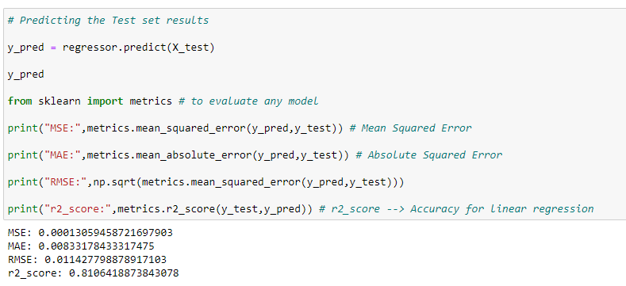
Apply linear regression
Converting all categorical data into numerical by .get_dummies() method.
Removing all unnecessary columns.
Input all remaining columns except price column as features of the model.
Then train them and test.
Prediction stage:

Slide 21

THANKS FOR ATTENTION!

